Slide 1
Building the Buildings and Serving Our Residents
Carmen Romero, President and CEO
APAH
LAIGW Meeting
December 15, 2023

Slide 2
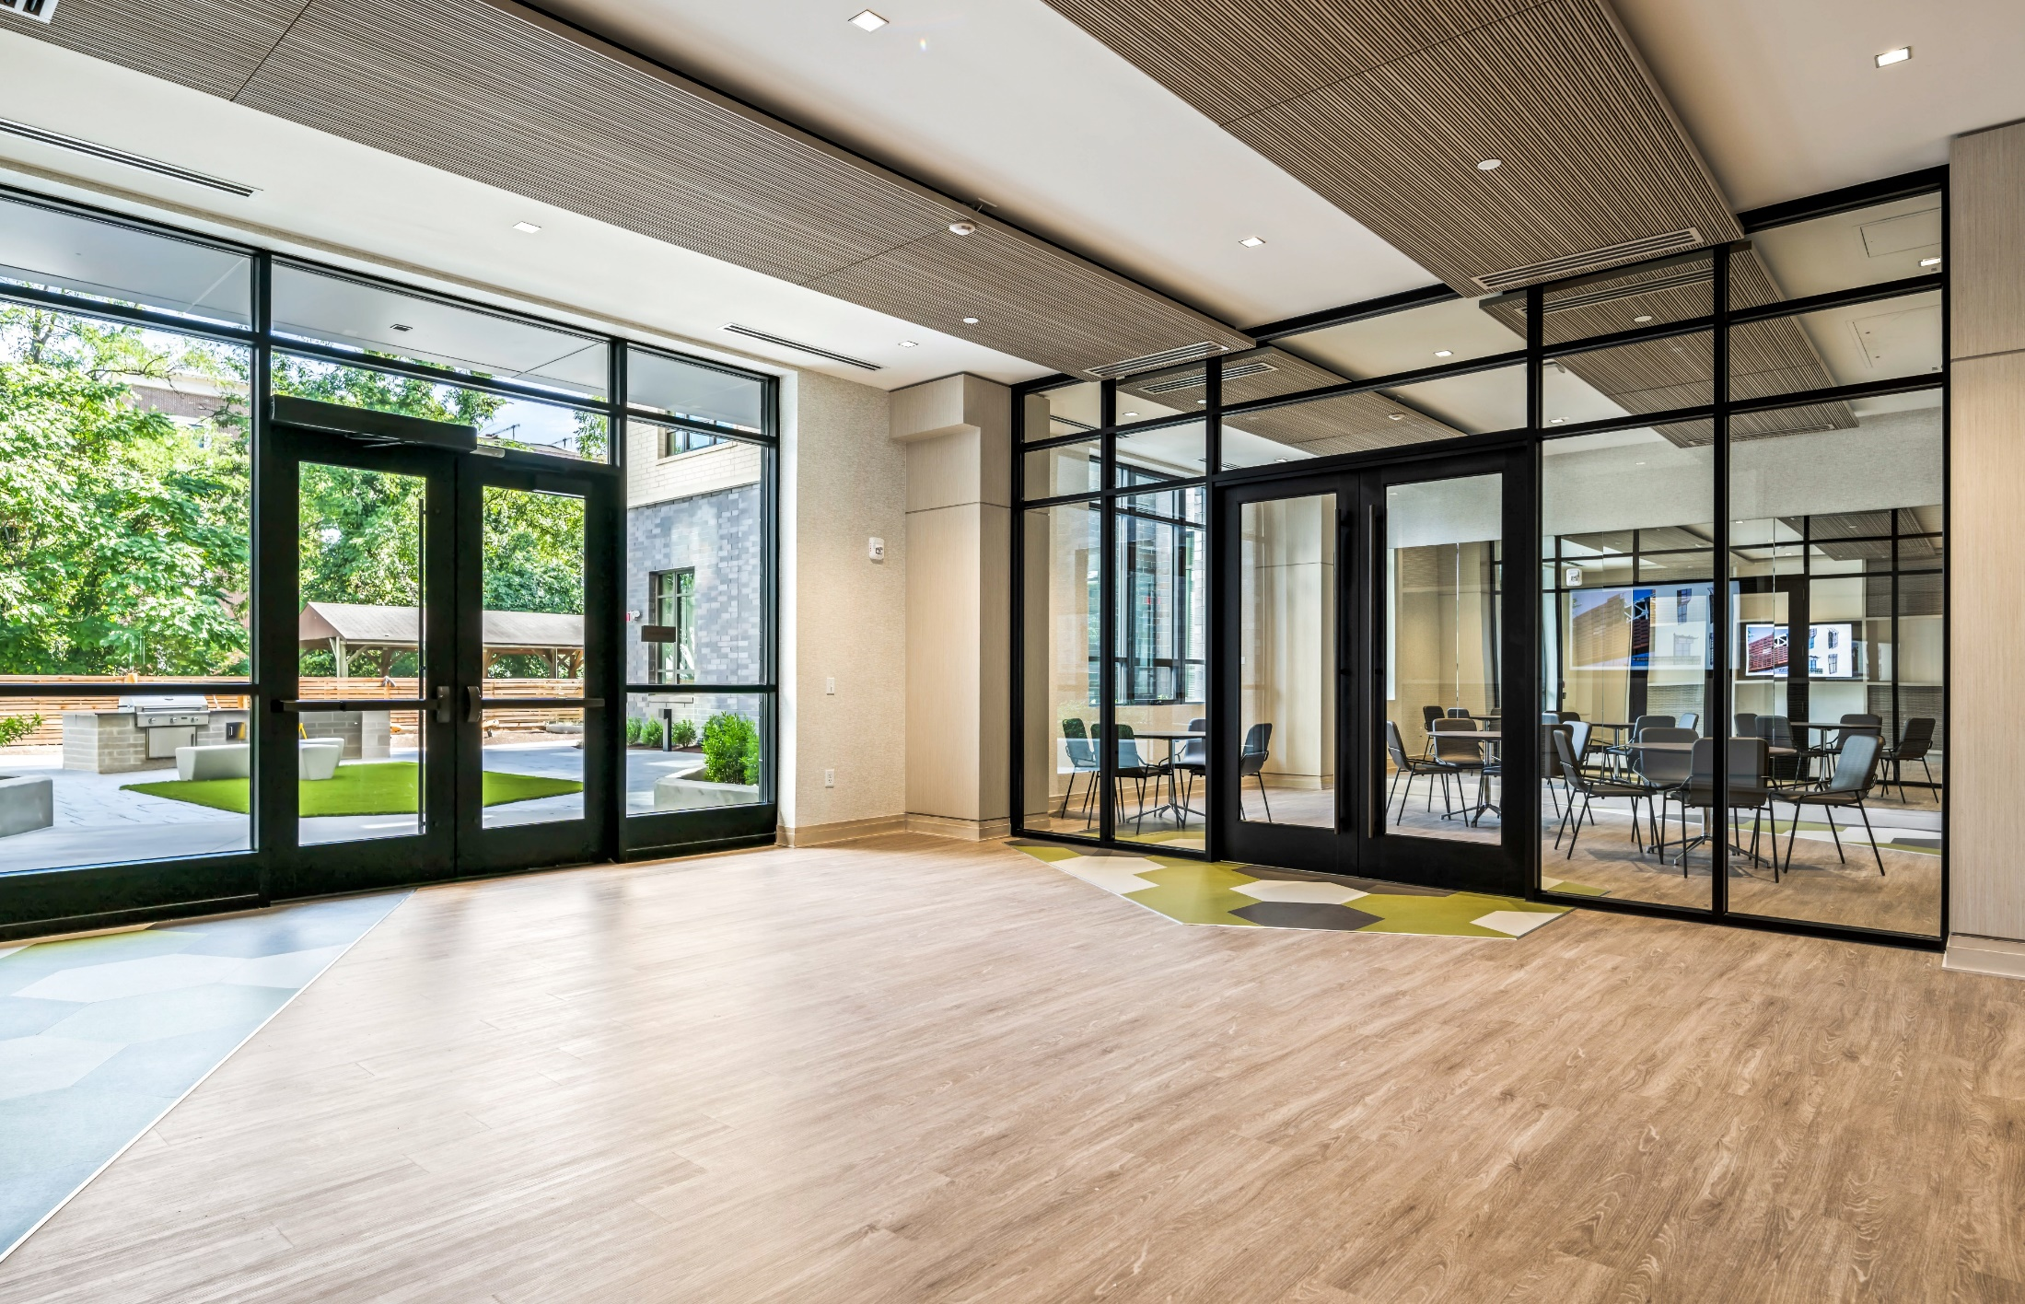
About APAH
Mission-driven, innovative housing developer
Owns over 2,490 homes with 2,000 units in active pre-development
Focused on 30% to 60% AMI, including 10% Permanent Supportive Housing
Promotes opportunity and stability for residents
Operates throughout the DMV with projects in 5 jurisdictions
Committed to racial justice
Wells Fargo Foundation Multipurpose Rooms
Notes:
Nina – 3:10-3:23 Strategic Planning Process – 13 MINUTES TOTAL
About APAH – 2 Minutes
Owns 1,363 rental homes at 15 properties; 811 units of new construction in the pipeline
Commitment to serving vulnerable populations, i.e. PSH
Model of mission-driven non-profit developer

Slide 3

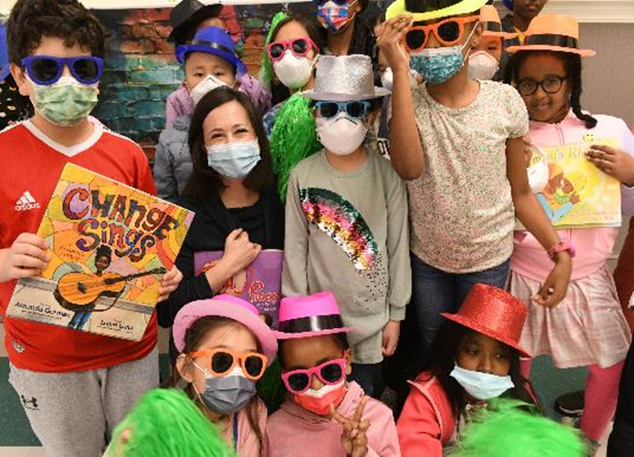
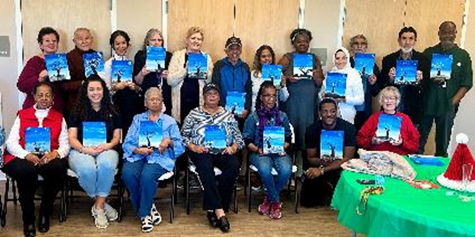
APAH’s Vision, Mission, & Values
Everyone deserves a place to call home - a foundation to live their dreams.
We exist to provide quality affordable housing and resident-centered programming to help our residents make the most of their home.
Excellence | Integrity | Collaboration | Innovation
Compassion | Impact | Racial Equity
Notes:
Nina – 3:10-3:23
Mission – 1 Minute
Adopted revised mission statement in September 2017
Greater focus on community impact – accelerated thanks to our partnership with Citi

Slide 4
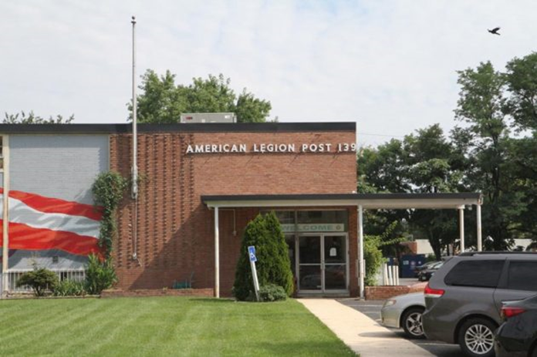
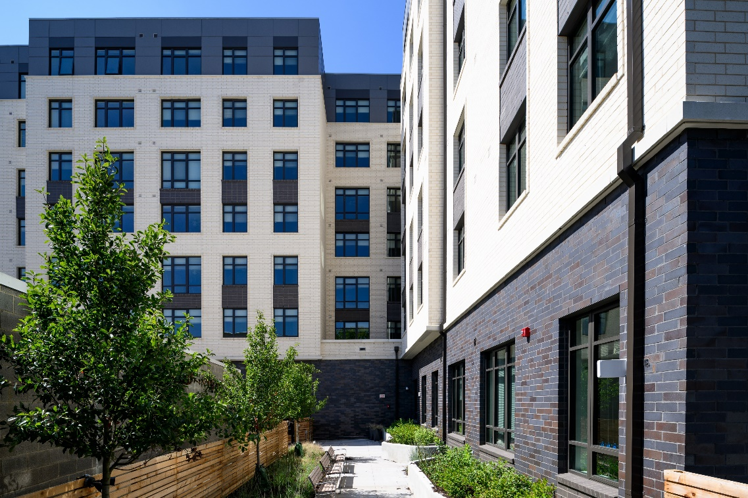
Terwilliger Place: A Case Study
A 100-Year History Ready for Transformation
  1.3-acre site in the heart of Arlington
  1950s facility in urgent need of costly repairs and upgrades
  Aging and declining membership
  Commitment to reimagining facilities and programming to meet the needs of the next generation of veterans
  160 affordable units walkable to VA Square metro station, groceries, parks and schools
  New 6,000 SF condo for the Legion Post
  50% of units have a veterans’ preference

Slide 5
Sources & Uses
including $2.1 Amazon funds

Slide 6
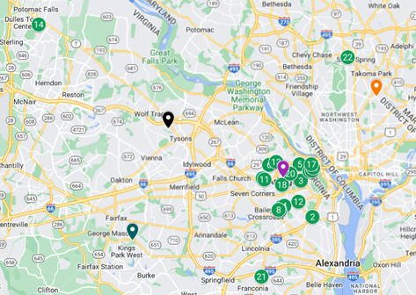
Where is APAH?
Arlington Mill Residences
Arna Valley View
The Barkalow
Buchanan Gardens
Calvert Manor
Cameron Commons
Columbia Grove
Columbia Hills
Courthouse Crossings
Fisher House
Fisher House II
Gilliam Place
Leckey Gardens
Loudoun View Senior Residences
Marbella
Parc Rosslyn
Queens Court
Snowden’s Ridge
The Springs
Lucille & Bruce Terwilliger Place
Oakwood Meadow Senior Residences
Falkland Chase
IN DEVELOPMENT:
Dominion Square
Ilda’s Overlook
Riggs Crossing
Unity at Ballston Station

Slide 7
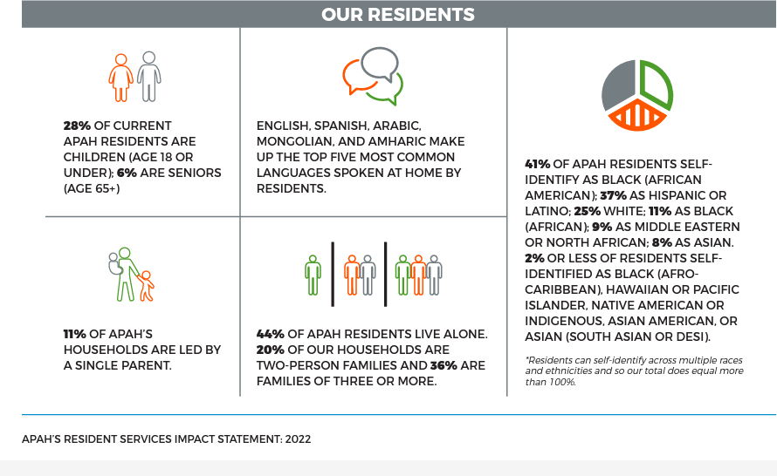
Who are APAH’s Residents?

Slide 8
Ensuring Resident Services Support
All Households
APAH’s CORES-certified 16-person Staff supports all properties with a 5 Pillar Approach
Uses a Racial Equity, Diversity, and Inclusion (REDI) Lens
Promotes opportunity
and stability
Resident-centered,
trauma-informed
Eviction moratorium and housing stability focus
Community Building
Resident Voice, GOTV
Volunteer Engagement
Digital Divide
Children Youth and Families
Workforce and Economic Mobility
Housing Stability
Adult Health and Wellness

Slide 9

Thank you!
4318 N Carlin Springs Road
Arlington, VA 22203
703.276.7444 | apah.org

