Slide 1

Lambda Alpha International, George Washington Chapter
DC Build Back Better Infrastructure Task Force
Friday, February 24th

Slide 2
BIPARTISAN INFRASTRUCTURE LAW (BIL)
WHAT’S IN THE BIL?
$1.2 trillion total funding to rebuild American Infrastructure
Funding supports over 400 new and existing programs across the Federal government
Half of new funding is going towards transportation sector
Additional funding areas include
  Highway funding
  Safety, rail, and multimodal transit programs
  Public transportation systems
  Energy systems
  Drinking water and wastewater programs
  Broadband and cybersecurity
WHAT’S IN THE BIL FOR D.C.?
$3.4 billion total allocation to the District of Columbia
Combination of formula funding allocations and competitive grant programs
$1.9 billion passes through to non-District agencies (e.g., WMATA, DC Water)
Over 80% of non-passed-through new funding will go to DDOT
Over $1 billion in funding has already been announced and allocated to DC with a focus on transportation, clean water initiatives, and high-speed internet access

Slide 3
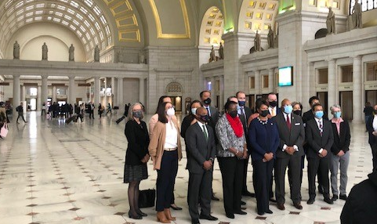
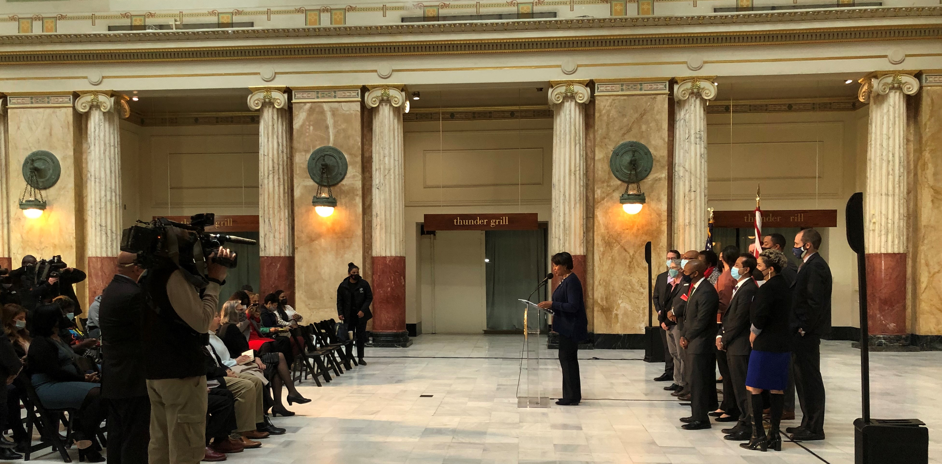
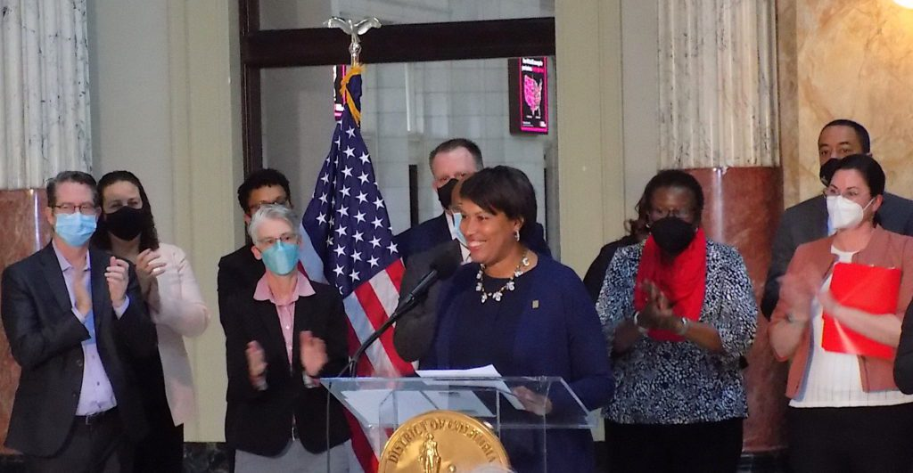
DC Build Back Better Infrastructure Task Force
Mayor Bowser announces the Task Force on March 24, 2022
MISSION
Identify transformational, equitable, sustainable, and achievable investments to make in order to maximize the impact of BIL funding for DC

Slide 4
BUILD BACK BETTER INFRASTRUCTURE TASK FORCE Cont. EXECUTIVE COMMITTEE Hon. Rodney Slater, CO-CHAIR Jan Adams, CO-CHAIR Dan Tangherlini Deryl McKissack Jennifer Reed Lucinda Babers Tommy Wells | SUB-COMMITTEE GOALS & LEADERSHIP
 | Goal | Chairs
ENVIRONMENT & RESLIENCE | Work towards a clean and healthy environment that is resilient for future generations | Tommy Wells, DOEE Brandi Colander, DC Green Bank
TECHNOLOGY INNOVATION | Prepare the District for a future ever more oriented around digitization, connectivity, and innovation | Lindsey Parker, OCTO Gabe Klein, Cityfi
TRANSPORTATION INNOVATION | Transform the way residents move across the city as DC transitions to a more sustainable, resilient, and interconnected future | Everett Lott, DDOT Cheryl Cort, Coalition for Smarter Growth
ADMIN, COMPLIANCE & PROCUREMENT | Enable the District to deploy and administer the increase in infrastructure funding from BIL efficiently and effectively | George Schutter, OCP Angel Brunner, EB5 Capital
WORKFORCE DEVELOPMENT | Ensure that District residents of all wards, races, and ages are equipped with the occupational skills, high quality training, and support they need to take advantage of career opportunities created by BIL investments | Unique Morris-Hughes, DOES Dyana Forester, AFL-CIO

Slide 5


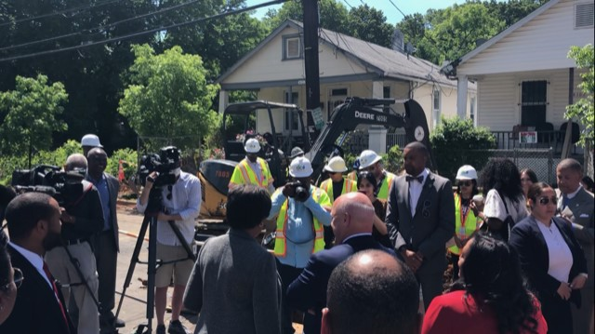
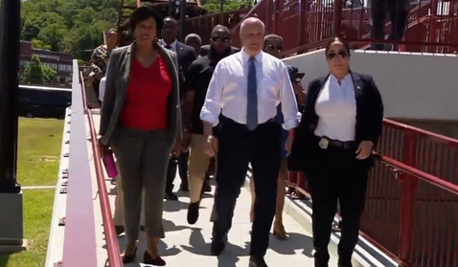
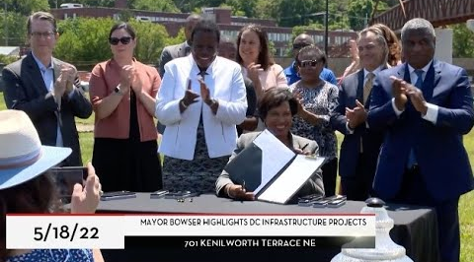
Task Force Timeline
DC Build Back Better Infrastructure Task Force
Report Released!
APRIL-AUGUST 2022
Sub-committees of public-sector and private-sector representatives met to develop recommended priorities
MARCH 2023
Implementation updates from District agencies
MARCH 2022
Task Force chartered by Mayor Bowser
NOVEMBER 2022
Recommendations highlighted by Mayor Bowser
D.C. Water Lead Replacement Site
DC/ i295 Pedestrian Bridge Walk
Signing of the DC Smart Lighting Contract
On May 18, 2022, Mayor Bowser was joined by White House Infrastructure Implementation Coordinator Mitch Landrieu, as well as members of the DC Build Back Better Infrastructure Task Force, community leaders, and local and federal government officials for a tour of transformative projects focused on making DC more connected, equitable, and sustainable.

Slide 6



Community Engagement
Task Force Process
Subcommittees held
In addition to the subcommittee-specific community outreach events mentioned in the previous slide, the Task Force also organized a community walk during Infrastructure Week in 2022.
Each of the Subcommittees conducted interactive workshops, field trips, and community engagement sessions from May to July of 2022 to translate the Task Force vision into more specific priorities.
Bi-weekly internal meetings
Community outreach events
Field trips
The Task Force also commissioned a public survey to solicit input from residents and use the results to inform their proposals.
The nearly 700 DC residents who responded prioritized the following goals for infrastructure improvements and investments:
Mitigate pollution and increase access to clean and renewable energy
Create strategies to lessen the impact of climate change
Increase access to public transportation, bike lanes, and pedestrian pathways
Focus improvements to ensure equitable access to tech, communications, and systems

Slide 7

DC Build Back Better Infrastructure Task Force Report
The report was released on November 17, 2022, at a regional safe streets event in ward 7. It can be found online at
www.infrastructure.dc.gov

Slide 8
Task Force Project Recommendations

Slide 9
Environment & Resilience Subcommittee Priorities
Convert existing District buildings into net zero, grid interactive buildings
Invest in clean transportation micro mobility hubs
Restore over 20 acres of tidal wetlands adjacent to Kenilworth Park North
Create new green gateways and centers of economic development
Expand recreation on the Anacostia River for all residents

Slide 10
Transportation Innovation Subcommittee Priorities
Expedite redesigns of Vision Zero’s 29 high-injury network corridors
Transform the North Capitol Corridor into an urban boulevard
Redesign the I-295 corridor to reconnect communities

Slide 11
Technology Innovation Subcommittee Priorities
Improve quality of life for District residents by building out a comprehensive network of sensors
Drive digital equity in DC through community organizations and broadband in Wards 5, 7 and 8
Accelerate opportunities in technology for DC residents

Slide 12
Administration, Compliance and Procurement Subcommittee Priorities
Adopt innovative flexible acquisition methods
Create efficiencies through streamlining of processes
Improve District business and worker engagement

Slide 13
Workforce Capacity Building Subcommittee Priorities
Establish a Green Jobs Academy
Build the capacity of the workforce system
Reimagine recruiting and advertising

Slide 14
BIL Implementation
How is the District planning to implement the Task Force’s recommendations?

Slide 15

 | Created: July 12, 2022, to help support the District’s efforts in securing and implementing funding from President Biden’s Bipartisan Infrastructure Law. Structure: Led by the Mayor’s Office of Budget and Performance Management and the Deputy Mayor for Operations and Infrastructure, with participation by District Department of Transportation Department of Energy and the Environment Office of the Chief Technology Office Cadence: Weekly coordination meetings and monthly leadership briefings Responsibilities: Tracking all grant opportunities and submission deadlines Supporting local agencies in formulating and developing grant applications Building and tracking opportunities to move Task Force priorities forward in FY24 and future budget cycles Aligning investments with the Mayor’s infrastructure vision Facilitating interagency coordination
The District’s
BIL Central Team

Slide 16

Formula Funds “Reality Check”
FFIS Projected 5-Year Allocation to DC |  | $3,416,907
Passthroughs to Non-DC Agencies |  | $1,920,855
FTA State of Good Repair Grants | WMATA | $1,352,440
Drinking Water State Revolving Fund | DC Water | $292,148
FTA Urbanized Area Formula Grants | WMATA | $175,177
FTA Bus and Bus Facilities Grants | WMATA | $62,560
FTA Enhanced Mobility Grants | MWCOG | $26,267
Affordable Connectivity Program (ACP) | Private ISPs | $9,080
FTA Metropolitan Planning | MWCOG | $3,183
DDOT Existing Program Funding Based on FY 2021 total funding received, projected through FY 2026 assuming no annual increases |  | $873,371
“New” 5-Year Funding Under BIL |  | $622,681
Bridge Formula Program | DDOT | $225,000
DDOT Existing Program “Plus-Ups” | DDOT | $192,922
PROTECT (Resilience) | DDOT | $29,783
Carbon Reduction | DDOT | $26,193
National EV Infrastructure (NEVI) | DDOT | $16,679
Clean Water State Revolving Fund | DOEE | $59,375
Clean Water Emerging Contaminants | DOEE | $25,497
Weatherization & State Energy | DOEE | $8,252
Energy Efficiency Block Grant | DOEE | $1,900
Energy Efficiency Loan Fund Capitalization | DHCD/DCGB | $4,432
Digital Equity & BEAD | OCTO | >$5,463
State and Local Cybersecurity | HSEMA | >$2,081
Other Funding Amounts TBD | various | $25,104
TRANSPORTATION ~$100 million/year
Half for bridges, and the other half for safety, resilience, and carbon reduction (incl. electrification)
ENVIRONMENT ~$20 million/year
Mostly for clean water, including green infrastructure, as well as energy efficiency
DIGITAL/BROADBAND ~$2 million/year*
For broadband and increased cybersecurity
*Another $20-25 million a year is expected for broadband and possibly another $2 million a year for cybersecurity.
Amount in thousands
Notes:
LEFT SIDE
FFIS says $3.4 billion
Over half of that passes through to non-DC agencies (56%)
Another quarter is funding DDOT was already going to receive (26%)
This is a conservative estimate, assuming Congress held funding flat for next 5 years
Leaves about $623 million over 5 years, or about $125 million a year
What’s in $25M “other”? These are here because they’re in FFIS but not confirmed by agencies
$8.3M in additional state and local cybersecurity
$7.7M for energy grid resilience for DOEE
$7.4M for motor carrier safety assistance program (for MPD?)

Slide 17
Next steps:
1
Collaborate with District agencies to determine the necessary steps for incorporating all priorities
2
Work with the Mayor’s budget team to see what new enhancements can be included in FY24 and future budget cycles
3
Track and apply for all competitive grant funding for Task Force priorities

Slide 18
THANK YOU!
Email: rich.harrington@dc.gov
Cell: 202-340-8569

